Slide 1


Getting Started with
New User Training

Slide 2




Agenda
WELCOME
Introductions
About Your Finance Program Plan
How it Works
Get Started
Notes:
[ID:Agenda]

Slide 3



Introductions
Shannon McAulay
Senior Finance Manager
Account Management,
Project Presentation Strategy,
Payment Option / Financing Strategy
Achai Broner, CMVP
Director, Energy Projects
Project Consultations
Energy Efficiency Expertise

Slide 4


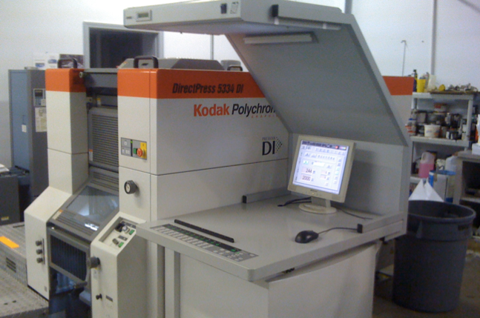

Financing Overcomes the Budget Hurdle
INTRODUCTION
88% of car purchases are financed
80% of home purchases are financed
80% of companies finance capital equipment
With financing I see that I can do this project.
Building Owner
Notes:
As I am sure you know; lack of budget is the number one reason projects and jobs don’t move forward. I assume you have heard that before in your selling, correct? In addition, speaking the economic language of the financial decision maker is also critical since they are the people who hold the purse strings. That is why (X) has decided to partner with Noesis. (X) joins the ranks of companies including HoneyWell, Trane, TD Industries, Daiken and many more who are overcoming these objections in the field.
Providing payment options at every step of your sales process is critical in not only overcoming the biggest objections they have but also giving you a big competitive advantage in the market and makes you a one stop, turn key solution, for your clients.
These building owners finance and use payment options to acquire over 80% of the equipment in their buildings. (Fork lifts, copiers, etc…)Energy related products are no different. Now you can provide them your equipment in a way they are used to paying for it.

Slide 5
Who is Noesis
INTRODUCTION

Slide 6
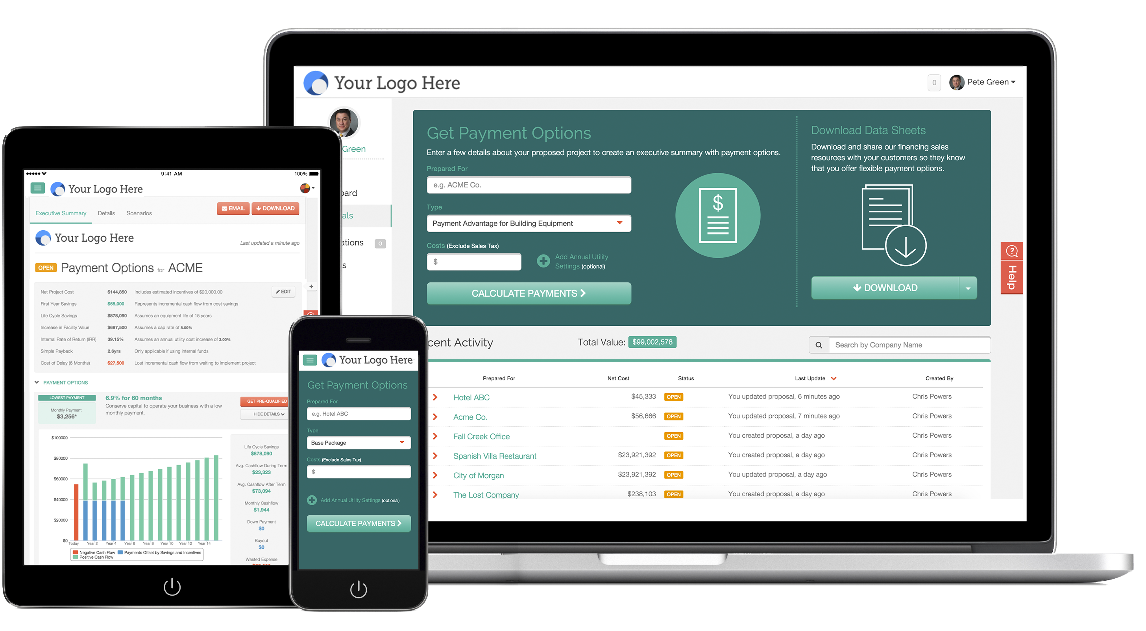
What You Get
INTRODUCTION

Slide 7
Benefits of Financing with Noesis
INTRODUCTION
1
Project sizes from $10,000 to $5 Million+
2
Easy online & paperless application (minutes!)
3
Fast approval process (hours!)
4
100% financing (including installation, other soft costs)
5
No lien on business / property, only equipment
6
Potential Tax benefits
Notes:
[ID:BenefitsOfFinancing]

Slide 8


Case Studies
INTRODUCTION
Equipment Replacement | Energy Efficiency Upgrade
Uptown Baptist Church | Downtown Hotel
Boiler | Chiller with VSD
$56,345 | $223,000
DOWNLOAD CASE STUDY
DOWNLOAD CASE STUDY
Notes:
Add links to Case Studies

Slide 9

Your Finance Program Plan
What is it?
A customized plan of credit products and associated fees.
Who Created it?
In collaboration with the executive sponsor
Why Was it Created?
To match your company’s sales process with Noesis credit products and deliverables

Slide 10
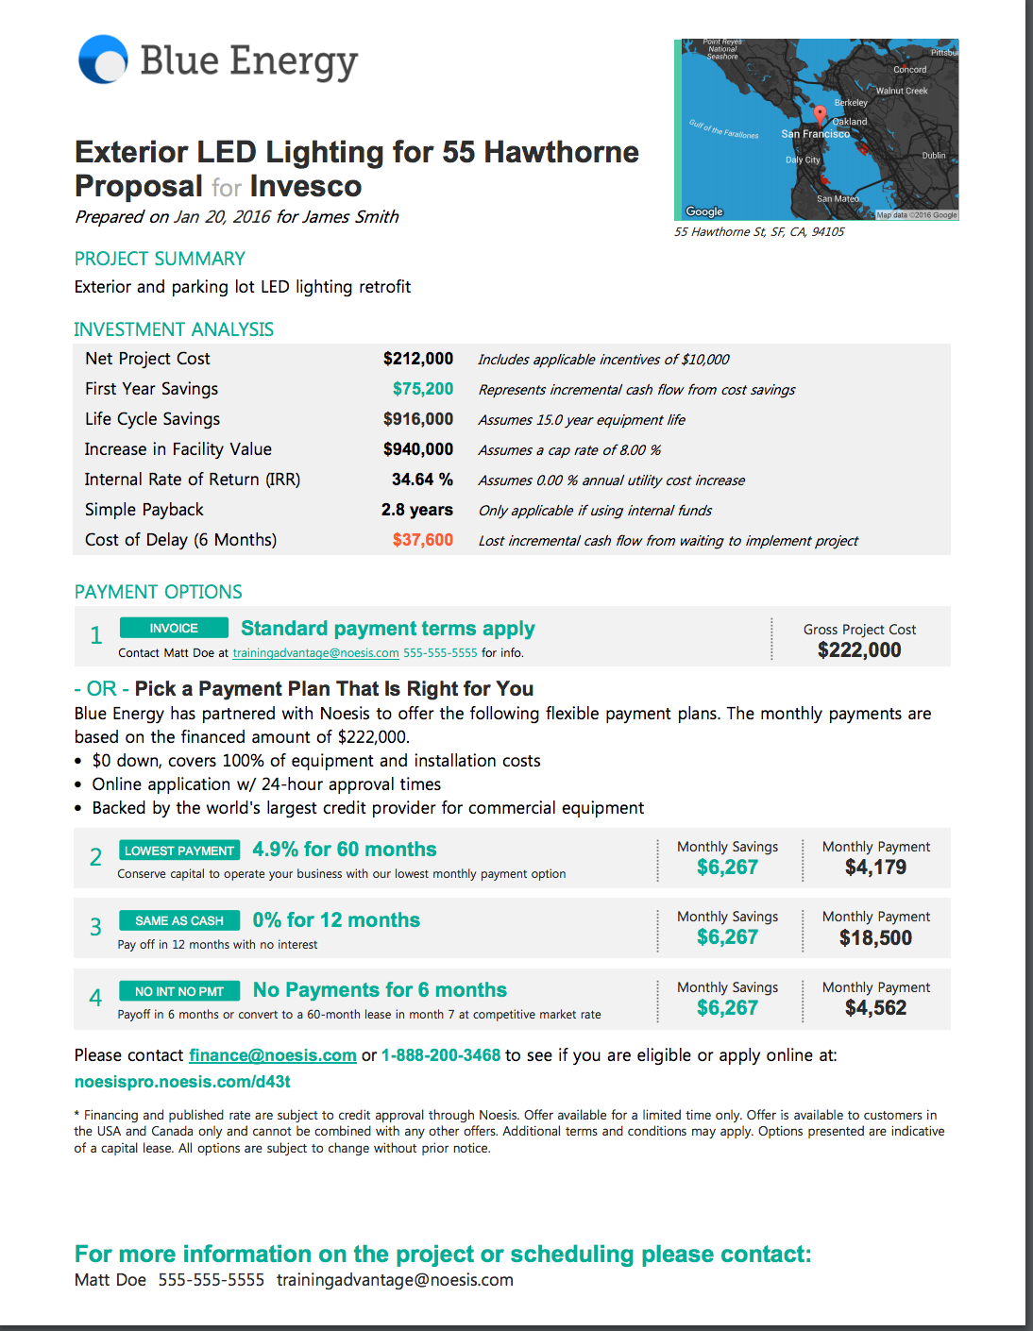
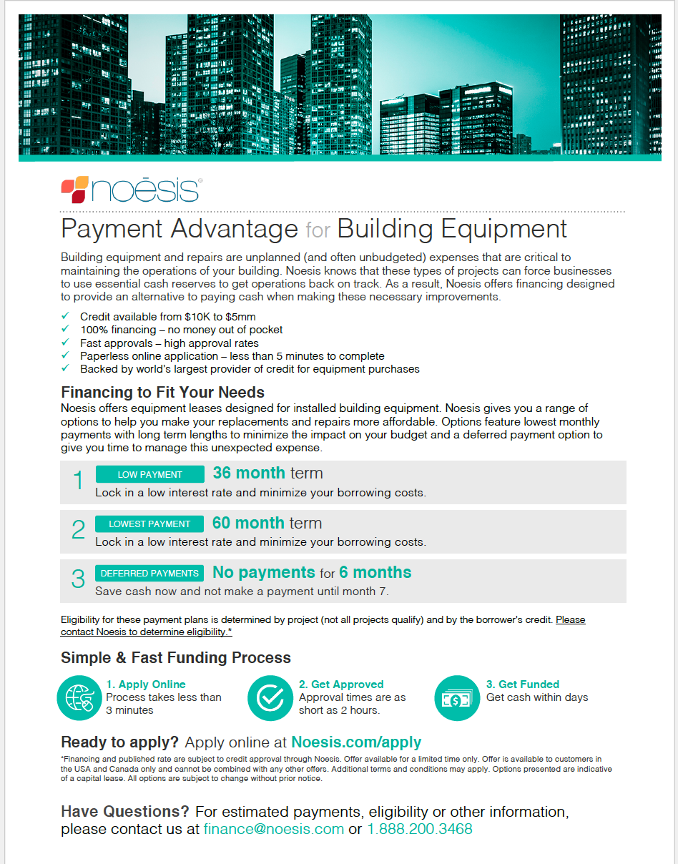
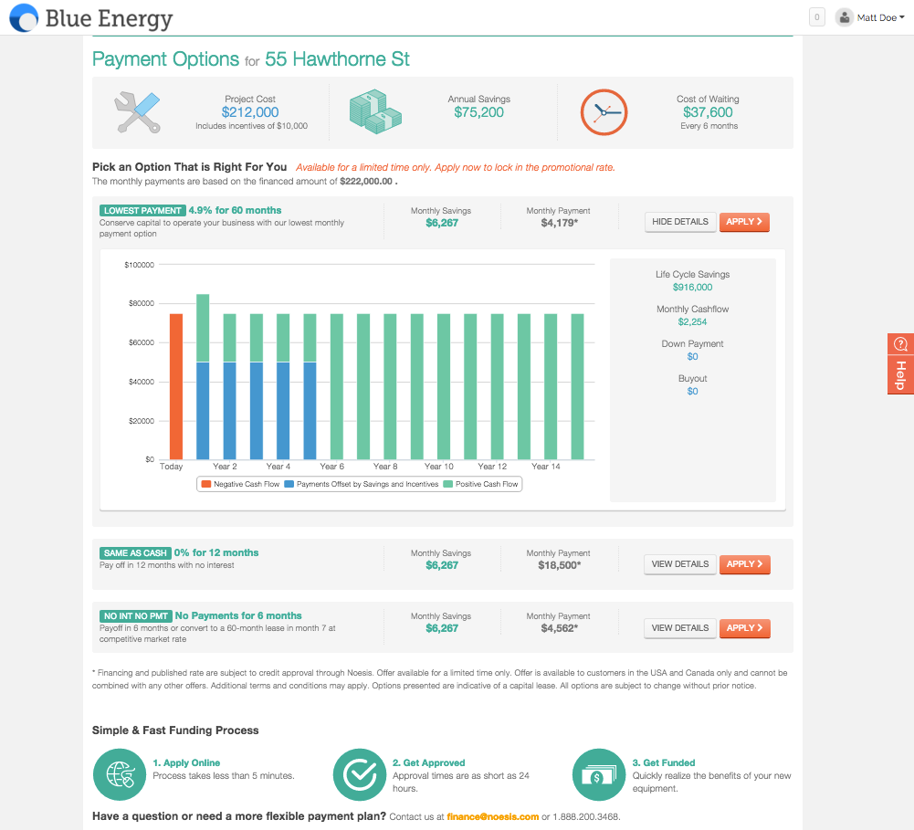
Where We Fit in Your Process
FINANCE PROGRAM PLAN
Prospect
Propose & Present
Follow-up & Close
Download Sales Resources
Use when visiting a customer for the first time or re-visiting an existing customer. Before your customer is ready to see a quote.
Executive Summary
The document includes an investment analysis and monthly payment options. Add to your existing quote/proposal for a customer.
Customer Webpage
Share Online: after presenting, share an online version with the Customer. Login to your portal & use the Email button
Customer can review cash flows and apply for credit
Get Updates: receive email updates when your Customer views the portal

Slide 11
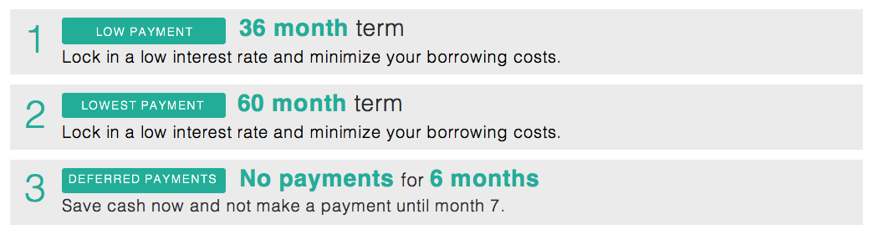
Credit Package 1
FINANCE PROGRAM PLAN
Payment Advantage for Building Equipment
About: Standard equipment financing with market competitive rates
When to Use: Plan/Spec, Cost Already Presented
Notes:
Make fees in separate box. Add Icon

Slide 12
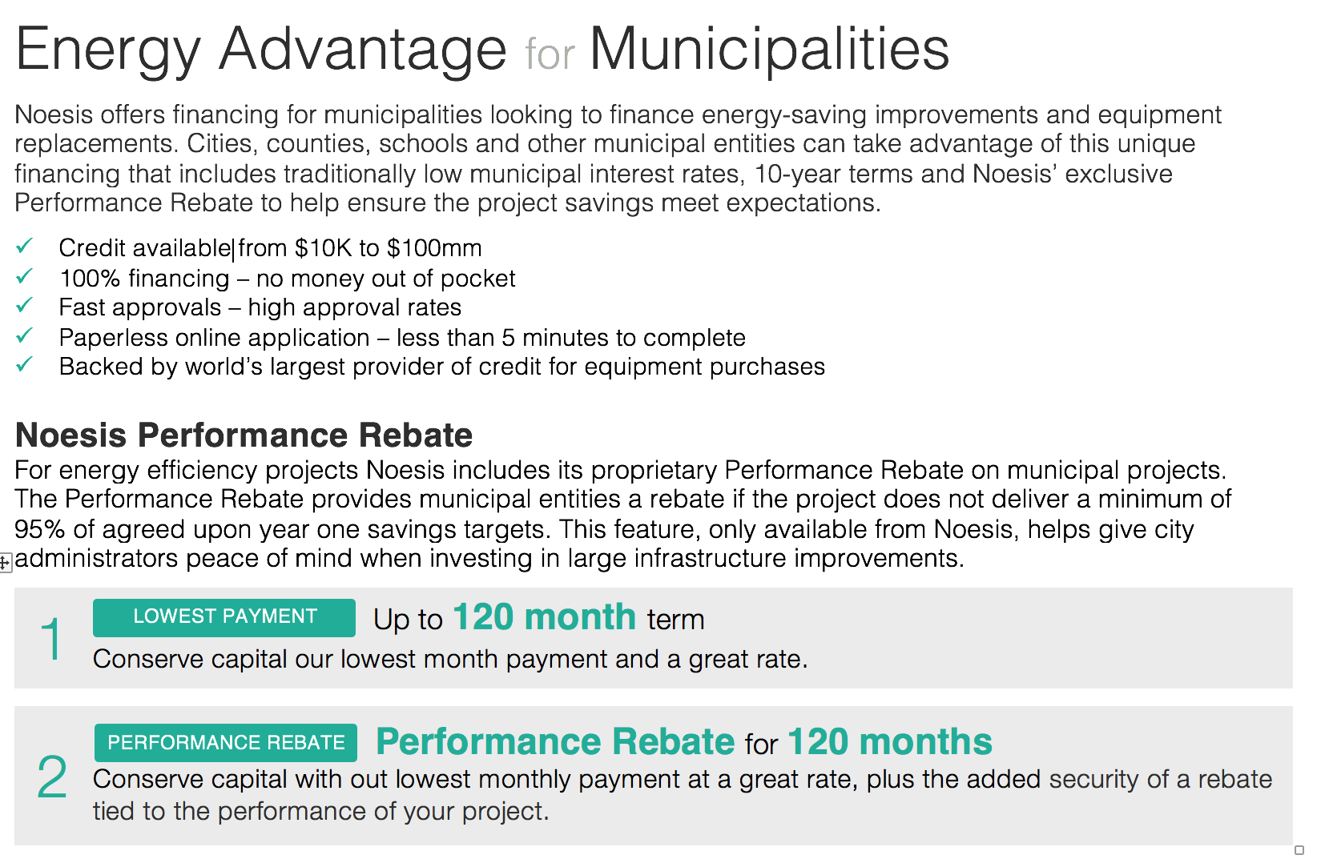
Credit Package 2
FINANCE PROGRAM PLAN
Energy Advantage for Municipalities
About: Tax-exempt financing for Municipal Entities with preferred terms. Credit available from $10,000 to $100 Million.
When to Use: The Noesis Performance Rebate allows you to guarantee savings, we perform third party M&V

Slide 13
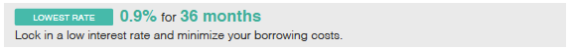
Credit Package 3
FINANCE PROGRAM PLAN
Payment Advantage Plus for Lighting & Controls
About: Promotional Financing Package to Create a Competitive Advantage
When to Use: Pepsi Challenge, Phased vs. Financed, Negotiated Work

Slide 14
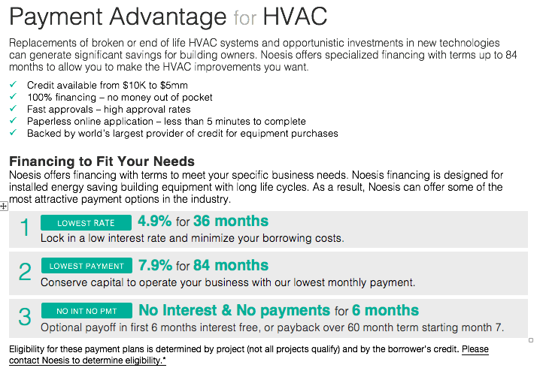
Credit Package 4
FINANCE PROGRAM PLAN
Payment Advantage for HVAC
About: Promotional Financing Package to Create a Competitive Advantage. Longer terms to match HVAC equipment life and paybacks
When to Use: Pepsi Challenge, Phased vs. Financed, Negotiated Work

Slide 15
Credit Package Fees
FINANCE PROGRAM PLAN
Credit Package | Fee* | When to Use
Building Equipment | 2.0% | Plan/Spec, Cost already presented
Municipalities | 1.5% | Municipal projects with no savings
Municipalities w/ Performance Rebate | 5.4% | Municipal projects with savings
Lighting and Controls Promotional | 9.9% | New Business, Negotiated price
HVAC Promotional | 9.9% | New Business, Negotiated price
*Fees will not be uplifted in platform. Ensure your project has fees built in.
*Fees will be uplifted in platform. Ensure prices on all deliverable match.
Notes:
Edit this slide according to actual packages

Slide 16
Selling with Payment Options
FINANCE PROGRAM PLAN
How should you incorporate fees? Your first inclination will be to show two prices, one for cash and one for financed. This will create a problem for you. If you do this, you will slow down your sale because you’ll be encouraging your customer to shop around for better financing. When your customers shops around for financing, according to a NY Fed report on small business lending, they will on average go to 3 different institutions and take between 20 and 30 hours filling out credit apps. That’s not 20 to 30 hours, half a week of work. That’s 20 to 30 hours at maybe 3-4 hours per week, amounting to at least a 2-month delay. That’s reflected in our own data.
A better option, which is what we’ve chosen with your executives, is to be prepared and incorporate the cost into your project. Then if your customer is leaning towards financing, you’re covered. Otherwise, if they start leaning towards using their budget, you can either negotiate a cash discount, or you’ll have a nice little boost to your margin.

Slide 17

How it Works
Noesis gives you many ways to offer your customer utility savings analysis and monthly payment options. You can now use a smart phone or tablet to estimate monthly payments from your account.

Slide 18
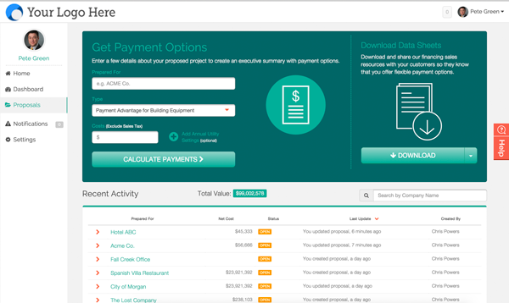
Walkthrough
HOW IT WORKS
In this walkthrough we will cover the following:
Get Payments Options
Payment Options w/ Utility Savings
Entering Final Costs Once Credit App Submitted
(Click links to watch demo video)

Slide 19
Noesis Q1 2016 Partner Incentive Program
HOW IT WORKS
Effective January 1, 2016 through March 31, 2016, Noesis will be offering
a $150 incentive for each credit application submitted by your prospects.
Notes:
Where did this content come from? Should we put this in the end? Once they know this info

Slide 20

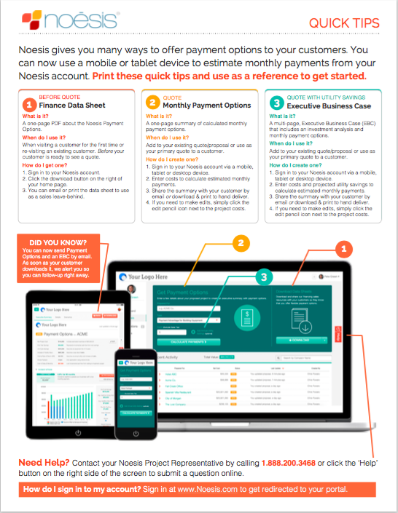
Get Started
Sign in at https://encycle.noesis.com and create your account.
Take a Test Drive - Present Payment Plans to three customers
DOWNLOAD & PRINT QUICK TIPS

